Slide 1
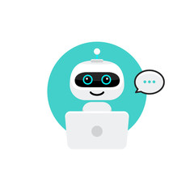
An Application of Chatbots Utilizing Machine Learning
Project Guide: Submitted By:
M. Sirisha V. Tharun Teja
Asst. Professor 2nd MCA
Department of Computer Applications JKC College, Guntur
JKC College, Guntur

Slide 2
INDEX
INTRODUCTION
ABSTRACT
ALGORITHMS
MODULES
UML DIAGRAMS
TECHNOLOGIES
SOFTWARE AND HARDWARE REQUIREMENTS
BENEFITS OF CHATBOT

Slide 3
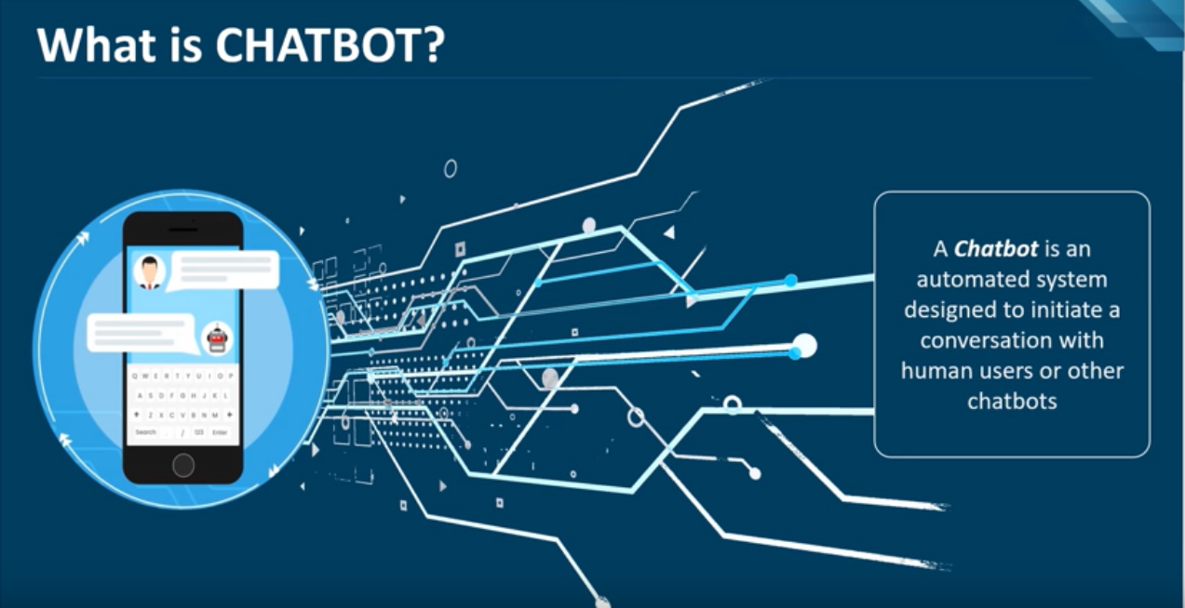

Slide 4
Introduction
In this Project we aim at making College Enquiry Chat Bot. Chat bots typically provide a text-based user interface, allowing the user to type commands and receive text as well as text to speech response.
Chat bots are usually a stateful services, remembering previous commands (and perhaps even conversation in order to provide functionality.
Chatbots are integrated into websites, apps and other messengers
When chat bot technology is integrated with popular web services it can be utilized securely by even larger audience.
Chatbots are often designed to convincingly simulate how a human would behave as a conversational partner. But however to decrease human effort chatbots came into existance.

Slide 5
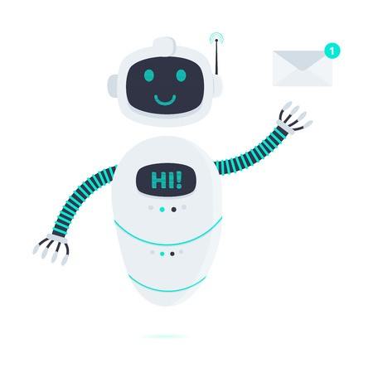
ABSTRACT
In recent years, the development of chatbot has become trendier and so far several conversational chatbots were designed which replaces the traditional chatbots. A chatbot is a computer program which is used to interact with humans and fulfill their needs. Chatbot gives the response for the user query and sometimes they are capable of executing tasks also. Early development of chatbots became so difficult whereas recent chatbots development is much easier because of the wide availability of development platforms and source code. A chatbot can be developed using either Natural Language Processing (NLP) or Deep Learning. When compared to traditional chatbots, bots designed using Deep Learning requires huge amount of data to train. The aim of this paper is to present, in what different ways the chatbot can be developed and their classifications. This paper also makes a discussion about the metrics for accessing the performance of bots. This helps in designing more effective bots.

Slide 6
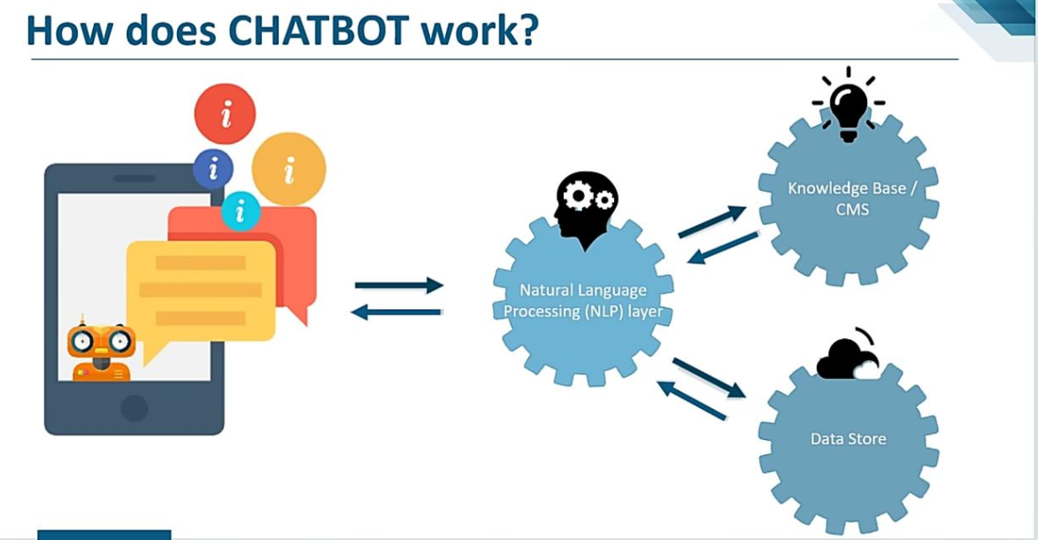

Slide 7
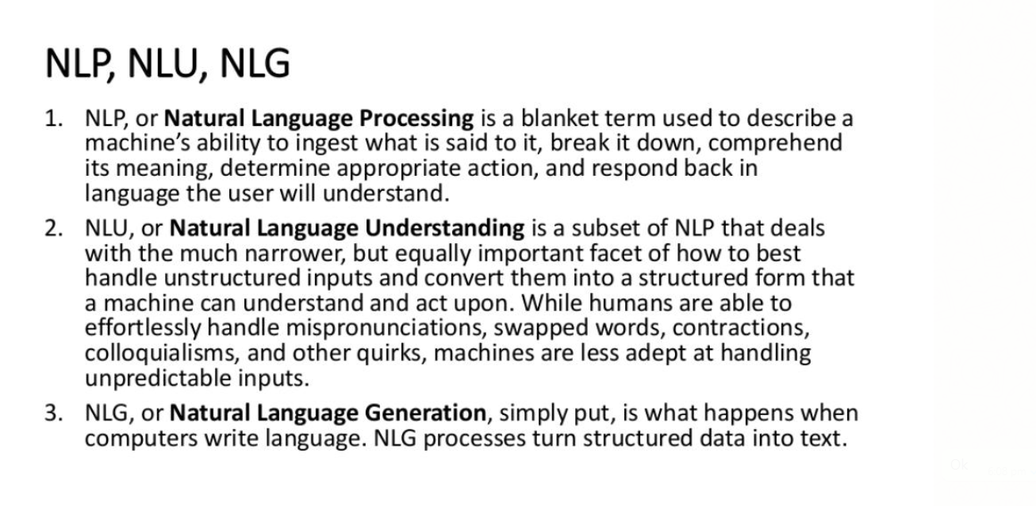
ALGORITHMS

Slide 8
MODULES
Natural Language Processing(NLP) Module
Dialogue Management Module
User Interface Module
Backend Services
Knowledge Base
Security and Compliance

Slide 9
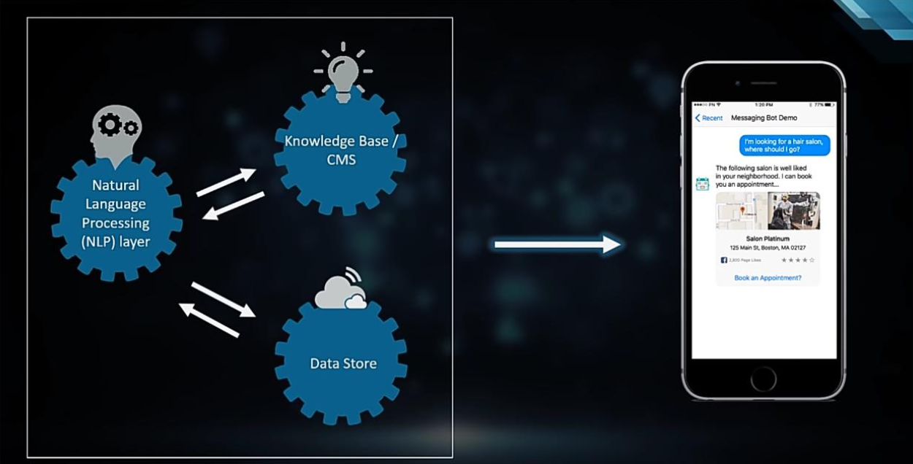

Slide 10
Technologies Involved
Artificial Intelligence -: Artificial intelligence is the main technology involved in chatbots. It’s meant to create something that can work and react like a human being. AI is used in many applications for error reduction, exploration, accomplishing repetitive tasks, and so on.
Machine learning -: A big part of AI these days is machine learning, which lets a chatbot learn how to better respond and provide helpful answers as it talks to more and more users over time. Machine learning can be made possible through various means such as neural networks, learning algorithms, and so on.
Python -: Artificial intelligence (AI) and machine learning are chatbot’s underlying technologies. They bring chatbot innovation, hence brand communication, to an entirely new personalized level. However Python also plays a major role in designing of a chatbot because the base for all the upcoming technologies like Artificial intelligence, Natural language processing and machine learning is Python.

Slide 11
SOFTWARE AND HARDWARE REQUIREMENTS
Software Requirements: Hardware Requirements:
*Operating System : Windows11 *Processor : 8Octa Core Processor
*Coding Languages : Python *RAM : 32GB RAM
*Front-End : Python *Hard Disk : 500GB hard disk
*Back-End : Django-ORM
*Designing : Html, Css, JavaScript
*Database : MySQL

Slide 12
Benefits of the Chatbot
User does not have to go personally to college office for the enquiry.
This application enables the students to be updated with college cultural activities.
This application saves time for the student as well as teaching and non teaching staffs.
The system has an effective graphical user interface due to which this system answers to the query as if real person is answering.

Slide 13
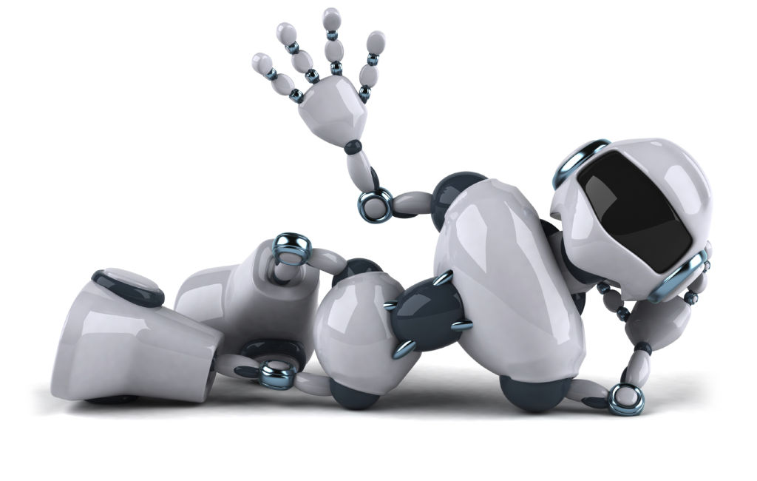
Thank You

